Slide 1


BCSE307L – Compiler Design
Module 6 – Code Generation

Slide 2
Code Generation
The final phase in our compiler model is the code generator.
It takes as input the intermediate representation (IR) produced by the front end of the compiler, along with relevant symbol table information, and produces as output a semantically equivalent target program
The target program must preserve the semantic meaning of the source program and must make effective use of the available resources of the target machine (Eg. Register Allocation)
Position of code generator

Slide 3
Code Generation
A code generator has three primary tasks:
Instruction Selection
Instruction selection involves choosing appropriate target-machine instructions to implement the IR statements.
Register Allocation and Assignment
Register allocation and assignment involves deciding what values to keep in which registers.
Instruction Ordering
Instruction ordering involves deciding in what order to schedule the execution of instructions.

Slide 4
Issues in Code Generation

Slide 5
Issues in Code Generation
Issues in Code Generation are:
Input to code generator
Target program
Memory management
Instruction selection
Register allocation
Order of evaluation
Notes:
The most important criterion for a code generator is that it produce correct code. Correctness takes on special significance because of the number of special cases that a code generator might face. Given the premium on correctness, designing a code generator so it can be easily implemented, tested, and maintained is an important design goal.

Slide 6
1. Input to code generator
Input to the code generator consists of the intermediate representation of the source program.
Types of intermediate language are:
Postfix notation
Quadruples
Syntax trees or DAGs
The detection of semantic error should be done before submitting the input to the code generator.
The code generation phase requires complete error free intermediate code as an input.
Notes:
The many choices for the IR include three-address representations such as quadruples, triples, indirect triples; virtual machine representations such as bytecodes and stack-machine code; linear representations such as postfix notation; and graphical representations such as syntax trees and DAG’s.
The front end has scanned, parsed, and translated the source program into a relatively low-level IR, so that the values of the names appearing in the IR can be represented by quantities that the target machine can directly manipulate, such as integers and floating-point numbers.
We also assume that all syntactic and static semantic errors have been detected, that the necessary type checking has taken place, and that type conversion operators have been inserted wherever necessary.
The code generator can therefore proceed on the assumption that its input is free of these kinds of errors.

Slide 7
2. Target program
The instruction-set architecture of the target machine has a significant impact on the difficulty of constructing a good code generator that produces high-quality machine code. The most common target-machine architectures are RISC (reduced instruction set computer), CISC (complex instruction set computer), and stack based.
A RISC machine typically has many registers, three-address instructions, simple addressing modes, and a relatively simple instruction-set architecture.
In contrast, a CISC machine typically has few registers, two-address instructions, a variety of addressing modes, several register classes, variable-length instructions, and instructions with side effects.
In a stack-based machine, operations are done by pushing operands onto a stack and then performing the operations on the operands at the top of the stack.

Slide 8
2. Target program
The output/target may be in form of:
Absolute machine language:
Absolute machine language program can be placed in a fixed memory location and immediately executed.
Small/simple programs.
Relocatable machine language:
Program can be placed in a dynamic memory location
The subroutine can be compiled separately. A set of relocatable object modules can be linked together (linker) and loaded for execution (loader).
Assembly language:
Producing an assembly language program as output makes the process of code generation easier, then assembler is require to convert code in binary form.

Slide 9
3. Memory management
Mapping names in the source program to addresses of data objects in run time memory is done cooperatively by the front end and the code generator using the symbol table.
We assume that a name in a three-address statement refers to a symbol table entry for the name.
From the symbol table information, a relative address can be determined for the name in a data area.

Slide 10
4. Instruction selection
The code generator must map the IR program into a code sequence that can be executed by the target machine.
The complexity of performing this mapping is determined by factors such as
the level of the IR
the nature of the instruction-set architecture
the desired quality of the generated code.

Slide 11
4. Instruction selection
Example: the sequence of statements
a := b + c
d := a + e
would be translated into
MOV b, R0
ADD c, R0
MOV R0, a
MOV a, R0
ADD e, R0
MOV R0, d
Here, the third and fourth statement is redundant, which can be eliminated.

Slide 12
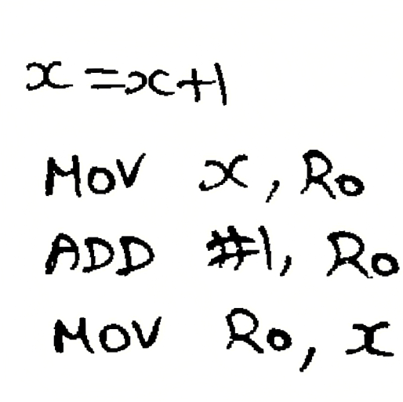
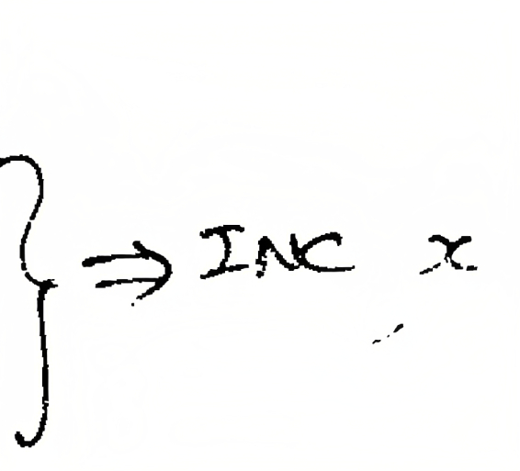
Cont…

Slide 13

5. Register allocation
A key problem in code generation is deciding what values to hold in what registers.
Instructions involving register operands are invariably shorter and faster than those involving operands in memory, so efficient utilization of registers is particularly important.
The use of registers is often subdivided into two sub problems:
During register allocation, we select the set of variables that will reside in registers at a point in the program.
During a subsequent register assignment phase, we pick the specific register that a variable will reside in.
Finding an optimal assignment of registers to variables is difficult, even with single register value.
Mathematically, the problem is NP-complete.

Slide 14
6. Order of evaluation
The order in which computations are performed can affect the efficiency of the target code.
Some computation orders require fewer registers to hold intermediate results than others.
Picking a best order is another difficult issue, NP-complete problem.

Slide 15
Approaches to code generation
The most important criterion for a code generator is that it produces correct code.
The design of code generator should be in such a way so it can be implemented, tested, and maintained easily.

Slide 16
The Target Machine

Slide 17
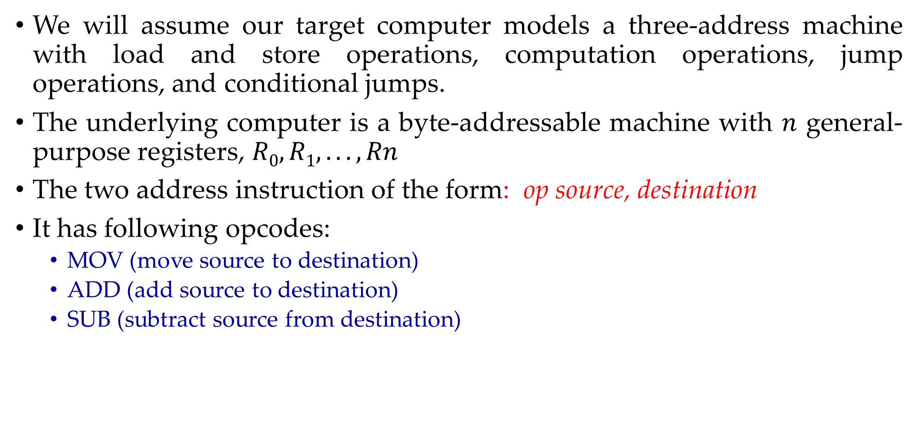
Target machine
We will assume our target computer models a three-address machine with load and store operations, computation operations, jump operations, and conditional jumps.
The underlying computer is a byte-addressable machine with $n$ general-purpose registers, $R0, R1, . . . , Rn$
The two address instruction of the form: op source, destination
It has following opcodes:
MOV (move source to destination)
ADD (add source to destination)
SUB (subtract source from destination)

Slide 18
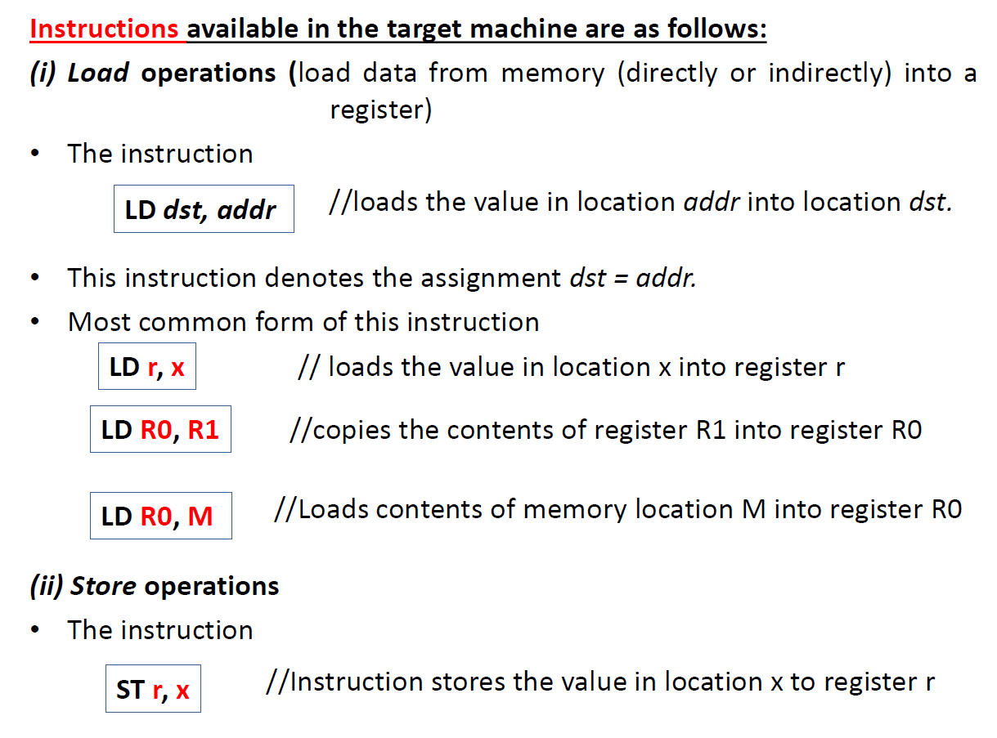

Slide 19
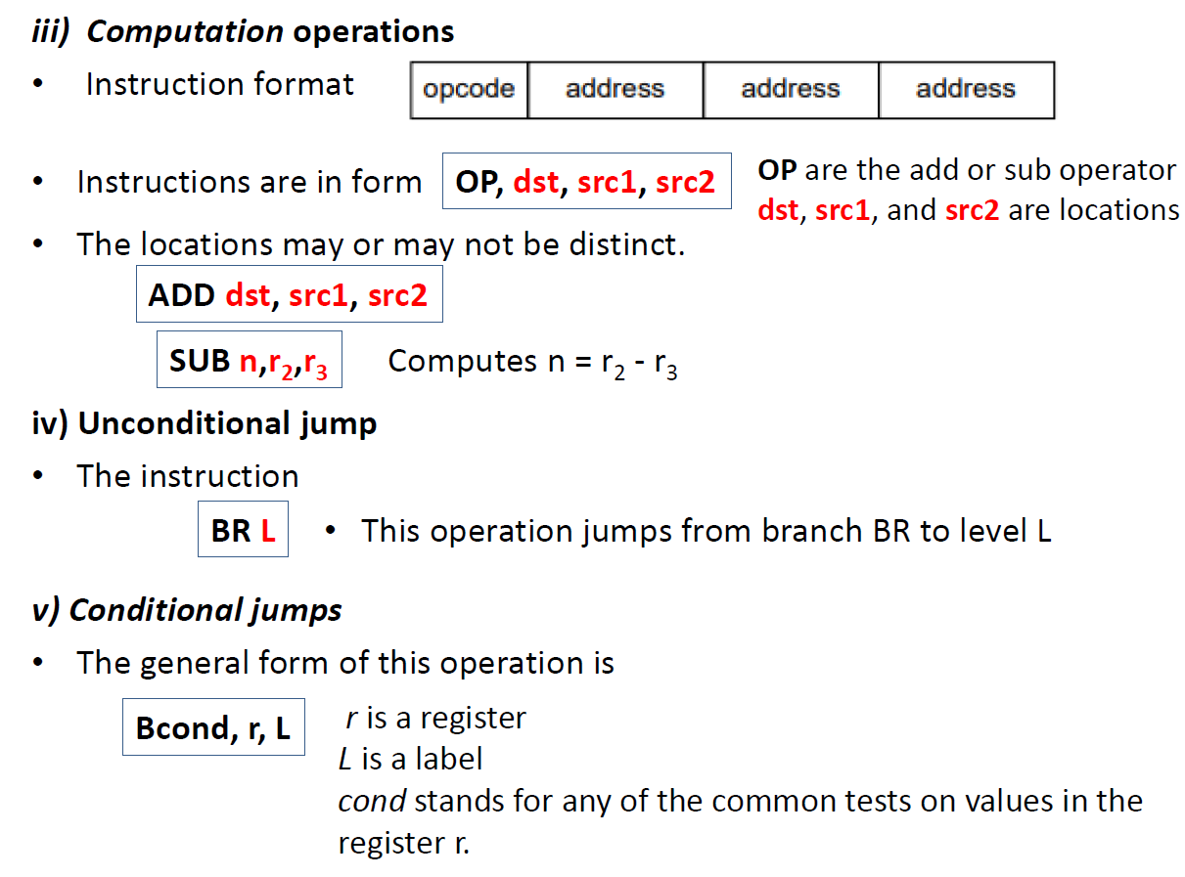

Slide 20
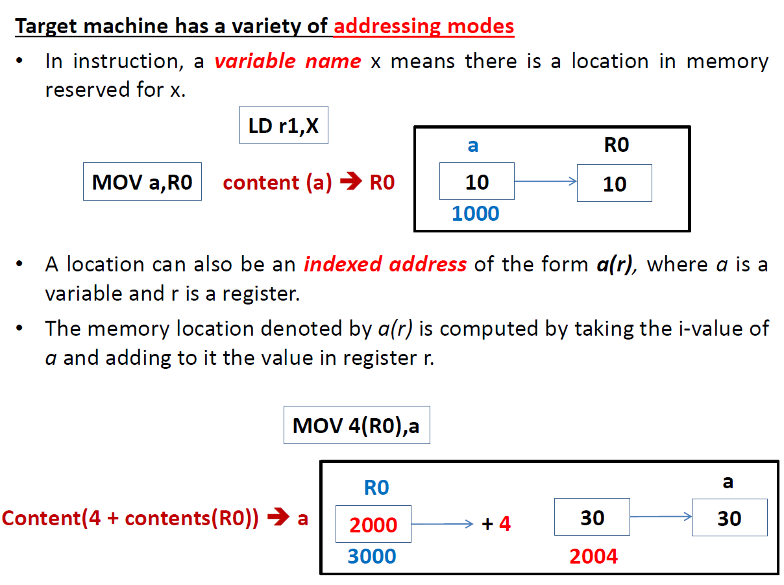

Slide 21
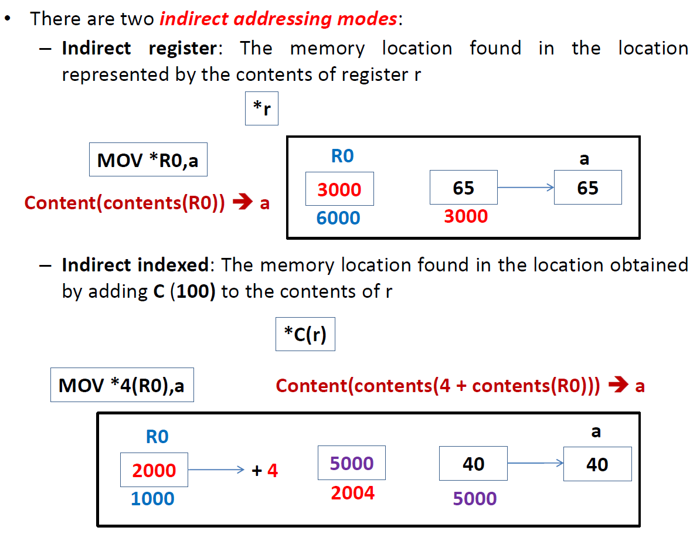

Slide 22


Slide 23
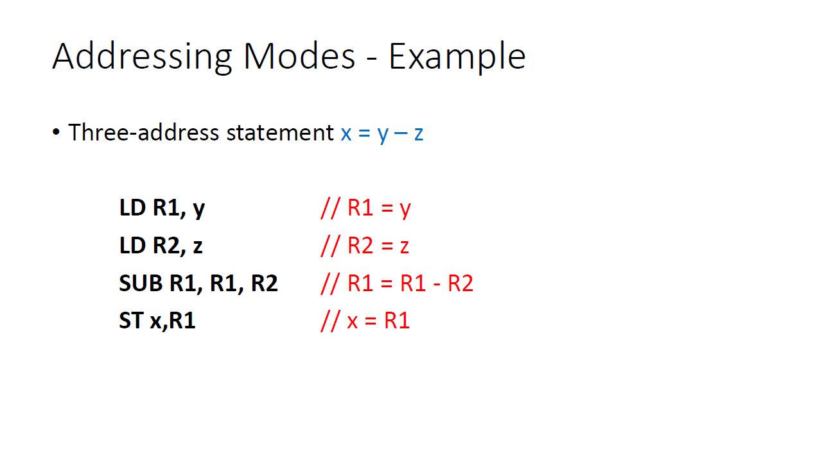

Slide 24
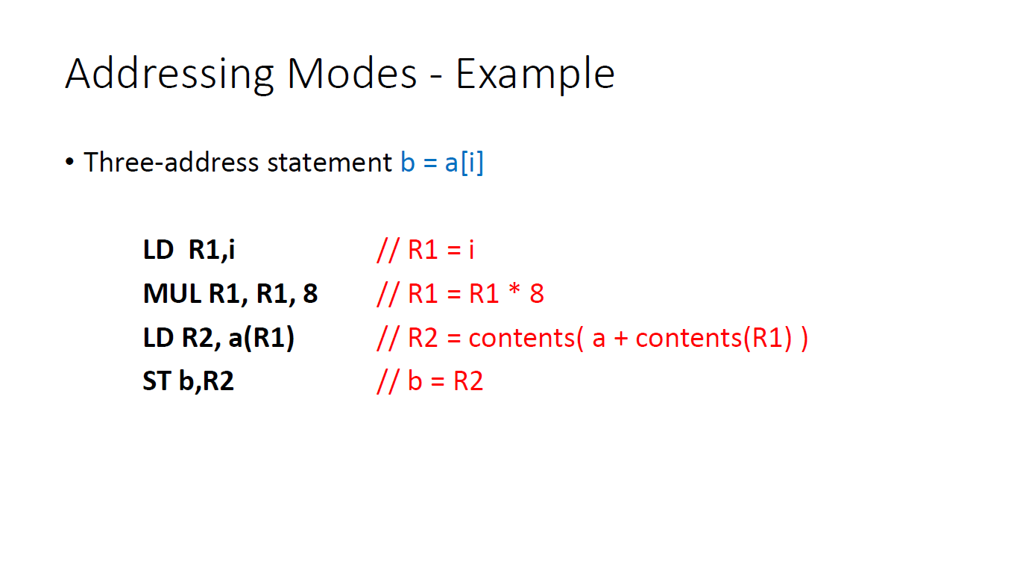

Slide 25
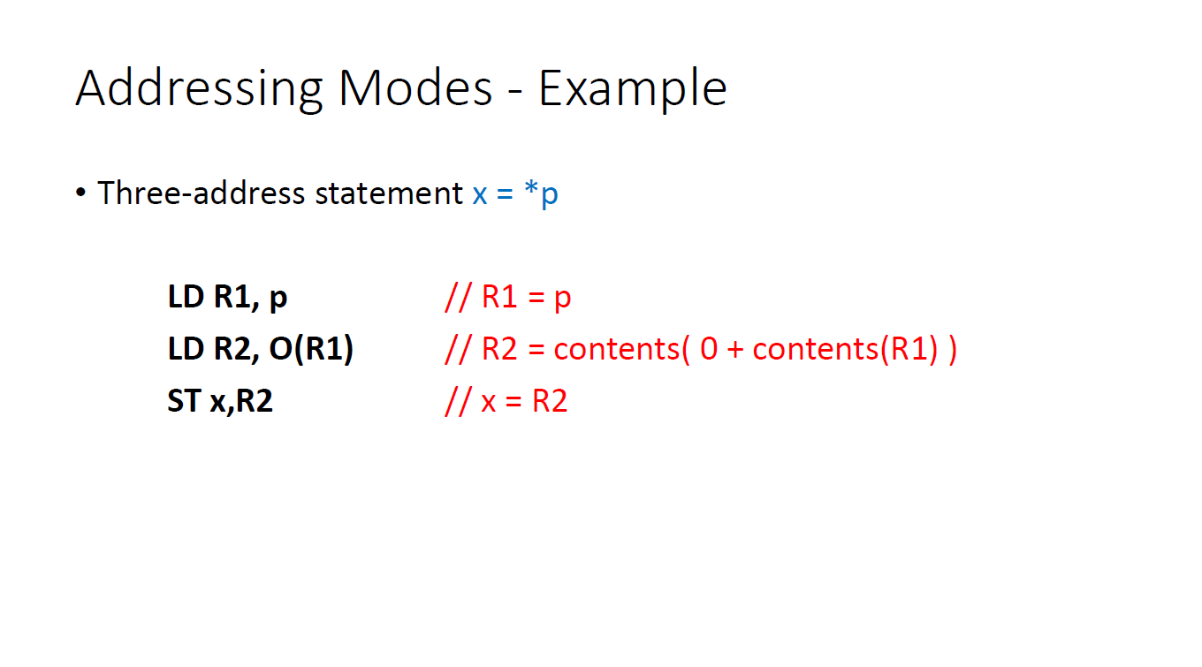

Slide 26
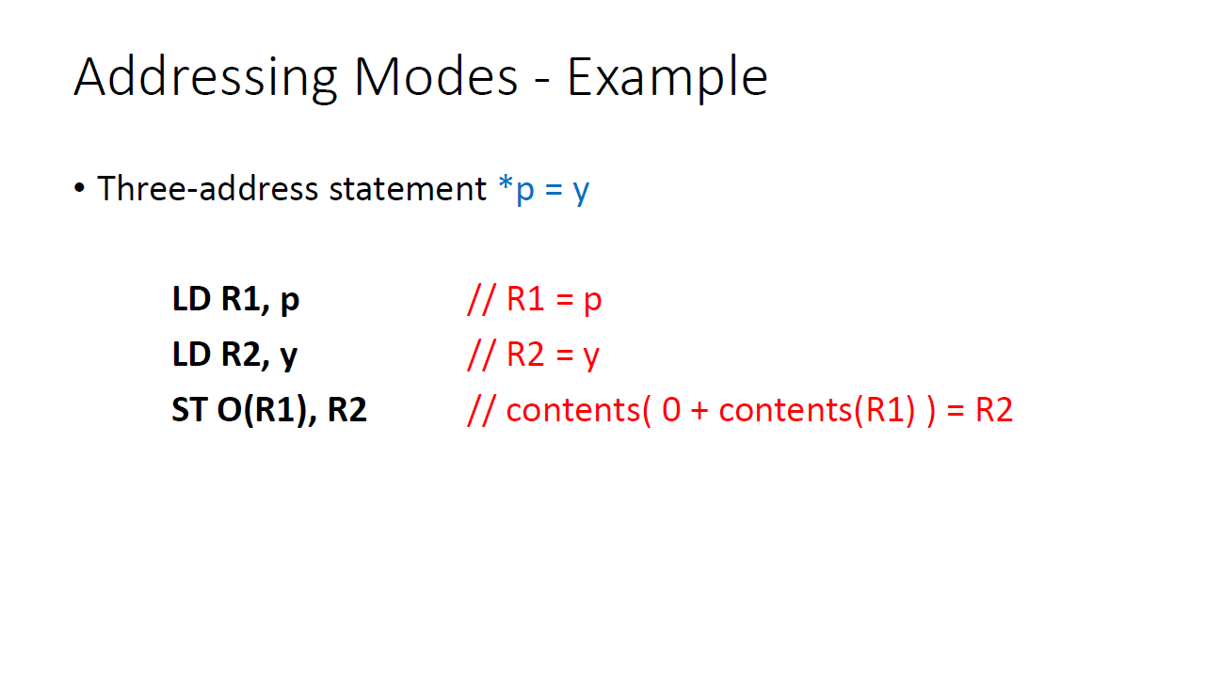

Slide 27
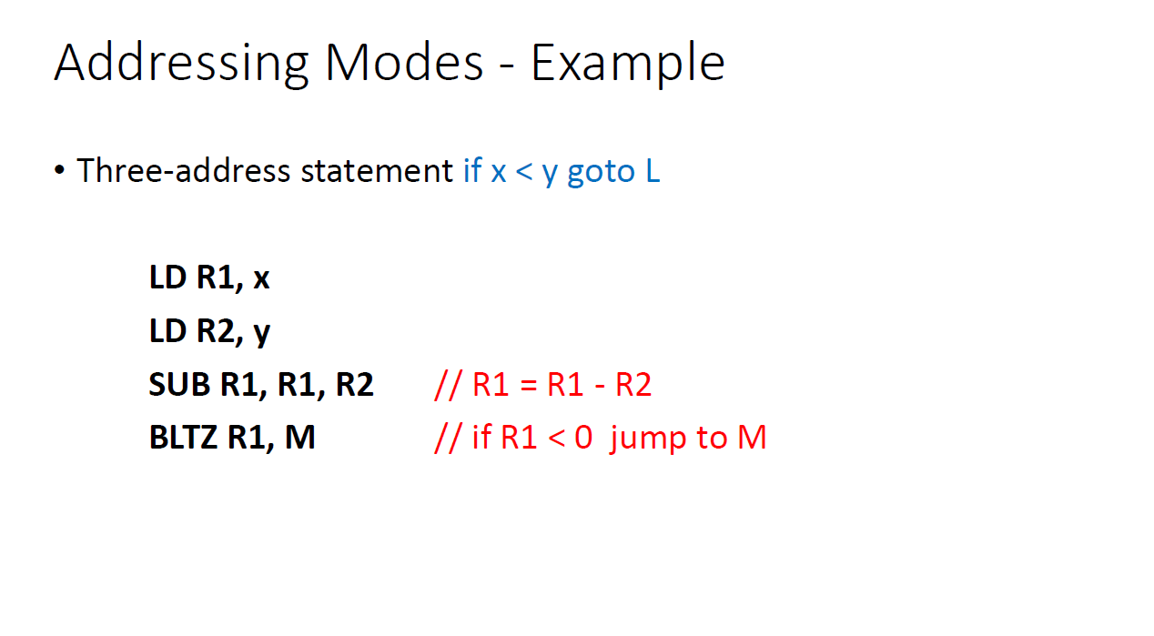

Slide 28
Instruction Cost
The address modes (to find the effective address) together with the assembly language forms and associated cost are as follows:
The instruction cost can be computed as one plus cost associated with the source and destination addressing modes given by “extra cost”.
Mode | Form | Address | Extra cost
Absolute | M | M | 1
Register | R | R | 0
Indexed | k(R) | k +contents(R) | 1
Indirect register | *R | contents(R) | 0
Indirect indexed | *k(R) | contents(k + contents(R)) | 1
Immediate or literal | #C | NA | 1

Slide 29
Instruction Cost
Calculate cost for following:
Mode | Form | Address | Extra cost
Absolute | M | M | 1
Register | R | R | 0
Indexed | k(R) | k +contents(R) | 1
Indirect register | *R | contents(R) | 0
Indirect indexed | *k(R) | contents(k + contents(R)) | 1
MOV B,R0 ADD C,R0 MOV R0,A | MOV B,R0→ cost = 1+1+0=2 ADD C,R0→ cost = 1+1+0=2 MOV R0,A→ cost = 1+0+1=2
 | Total Cost=6

Slide 30
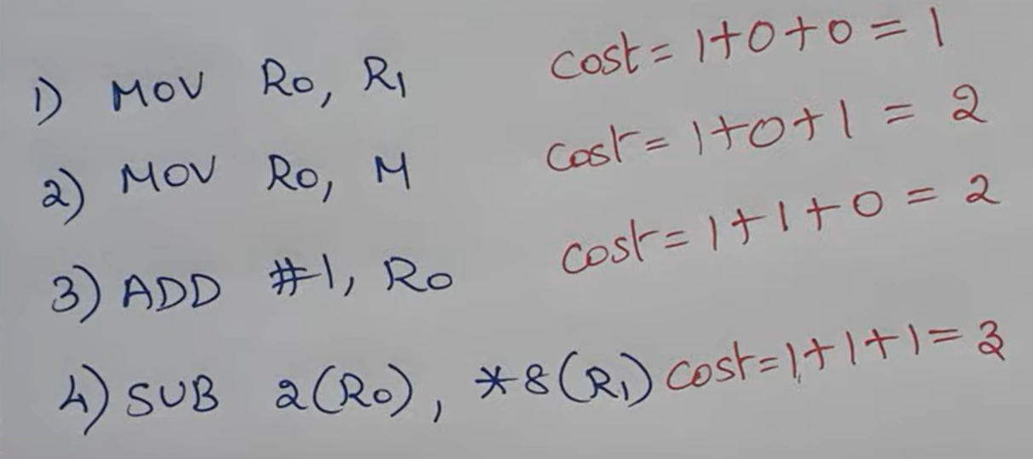
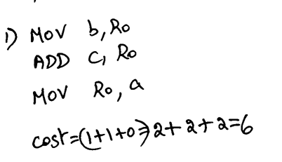
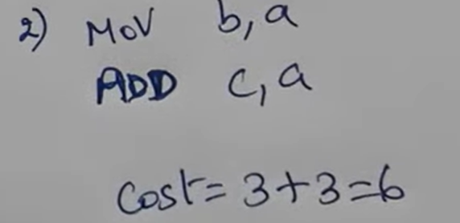
Example

Slide 31
Instruction Cost – Cont…
Calculate cost for following:
Mode | Form | Address | Extra cost
Absolute | M | M | 1
Register | R | R | 0
Indexed | k(R) | k +contents(R) | 1
Indirect register | *R | contents(R) | 0
Indirect indexed | *k(R) | contents(k + contents(R)) | 1
MOV *R1 ,*R0 ADD *R2 ,*R0 | MOV *R1 ,*R0 → cost = 1+0+0=1 ADD *R2 ,*R0 → cost = 1+0+0=1
 | Total Cost=2

Slide 32
Instruction Cost – Cont…
Calculate cost for following:
Mode | Form | Address | Extra cost
Absolute | M | M | 1
Register | R | R | 0
Indexed | k(R) | k +contents(R) | 1
Indirect register | *R | contents(R) | 0
Indirect indexed | *k(R) | contents(k + contents(R)) | 1
ADD R2 ,R1 MOV R1, a | ADD R2 ,R1 → cost = 1+0+0=1 MOV R1, a → cost = 1+0+1=2
 | Total Cost=3

Slide 33
Next Use Information

